Slide 1



Predicting Immune-Related Adverse Events in ICI Therapy Using Machine Learning
Presentation By: Austin Cherian

Slide 2
Why Predict Immune-Related Adverse Events?
🏥 The Clinical Challenge
Immune Checkpoint Inhibitors (ICIs) have transformed cancer treatment, especially in melanoma.
However, ~30% of patients develop immune-related adverse events (irAEs) — toxic side effects from immune activation.
These can be life-threatening or lead to treatment discontinuation.
Clinicians currently lack tools to identify high-risk patients before starting therapy (reactive vs proactive management).
🤖 The Opportunity for AI
Can we use baseline EHR data to predict irAE risk before therapy begins?

Slide 3
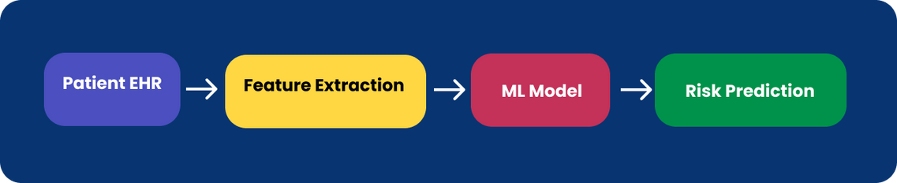
Project Overview
🧬 Dataset Overview : ~230 melanoma patients receiving ICI therapy from a clinical registry. 🎯 Prediction Target: Binary classification – irAE vs no irAE (any grade, any type). ⚙️ Features Used: Demographics, ECOG performance status, treatment regimen, lifestyle, comorbidities, autoimmune history, etc. 🚧 Key Constraint: All features were available at or before treatment start – model is intended to be prospective and actionable. | 🔎 Project Goal Build a machine learning model to predict the risk of developing irAEs using baseline EHR data from melanoma patients.

Slide 4
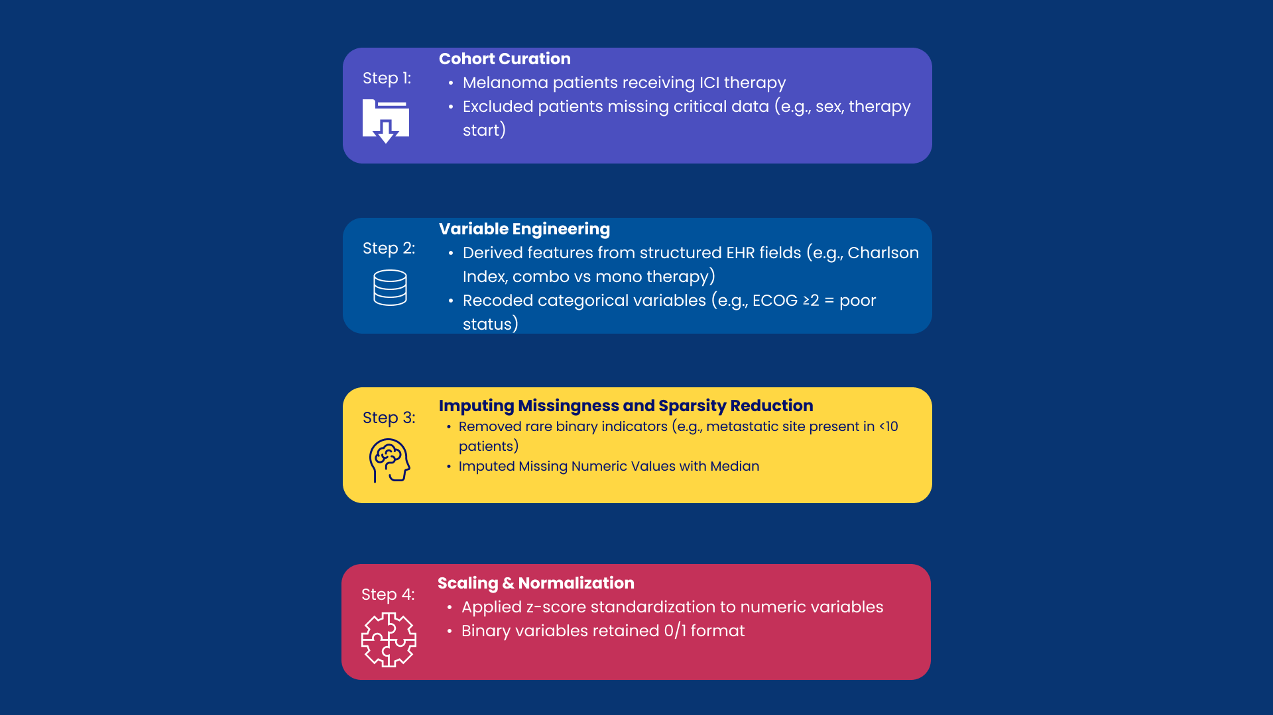
Data Curation & Feature Engineering

Slide 5
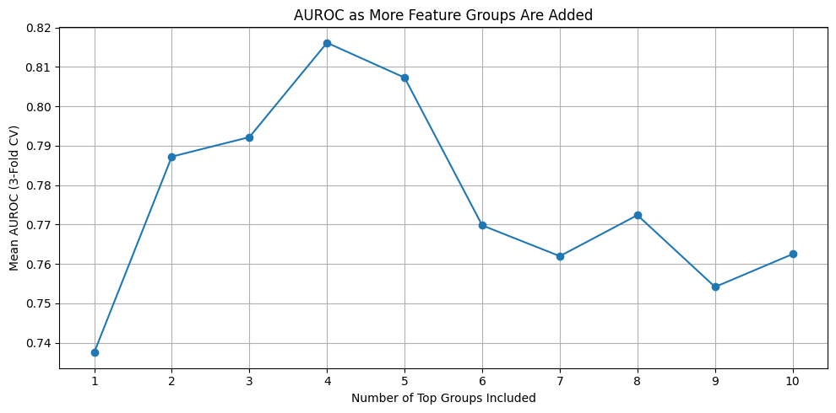
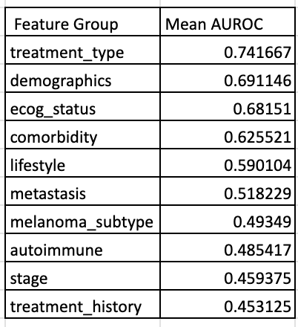
Model Approach Pt.1
📊Feature Selection
Trained different feature groups (i.e.treatment type, lifestyle factors, etc.)
Determined which combo of feature groups produces the highest AUROC
Best group: treatment_type + ecog_status + lifestyle + automoimmune

Slide 6
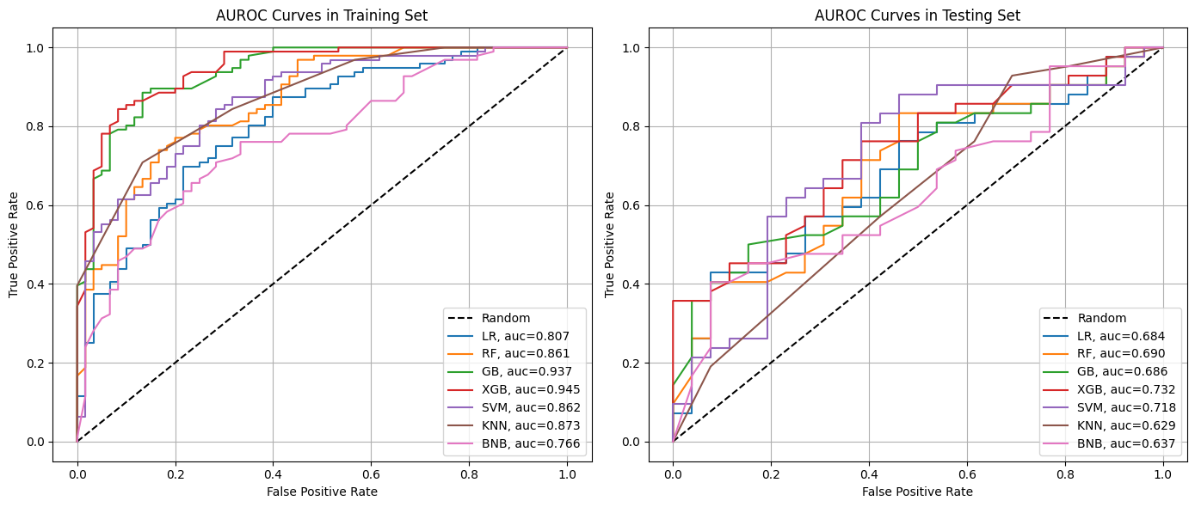
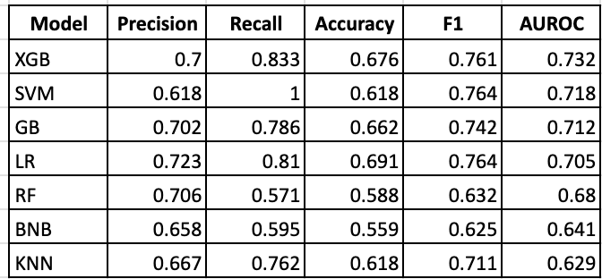
Model Approach Pt.2
🏋️‍♂️ Models Training and Tuning
Trained 7 models, including XGBoost, Random Forest, SVM
used GridSearch with 10-fold stratified cross-validation for hyperparameter tuning

Slide 7
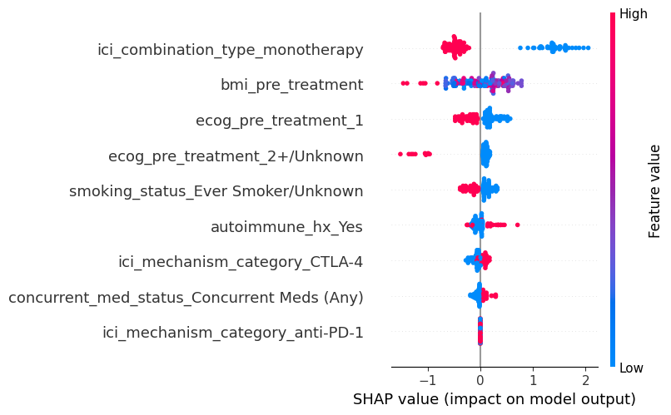
Feature Importance & Interpretability
🏋️‍♂️ SHAP Analysis
Most Predictive Features:
Treatment type (e.g., combination vs monotherapy) was the strongest predictor.
ECOG performance status and lifestyle (BMI, smoking) also contributed heavily.
SHAP values from XGBoost revealed:
Higher BMI and younger age increased irAE risk.
Combination therapy (e.g., ipilimumab + nivolumab) had strong positive impact on risk score.
Clinical Usefulness:
Transparent models support shared decision-making and risk discussions with patients.

Slide 8
Study Limitations -> Future Directions
⚠️ Limitations |  | 🚀 Future Directions
Single data source and disease (melanoma) limits generalizability |  | Integrate data subset with rest of IO registry.
Baseline-only features: time-varying labs and unstructured data excluded. |  | Include lab trends, biomarkers, and NLP-derived features from clinical notes.
irAEs were modeled as a binary outcome only — no subtype or severity distinction. |  | Expand prediction targets to include irAE subtypes and severity levels.
Lead-Lag Time Bias: Did not control for ICI dose count, follow-up time, or survival — due to sample size constraints. |  | Filter for patients who didn’t drop out due to death, and demonstrate observation window was sufficient for irAE onset

Slide 9
Study Limitations -> Future Directions
🩺 Clinical Implications
A validated model could enable pre-treatment irAE risk scoring to guide:
High-risk patients: closer monitoring, education, early intervention.
Low-risk patients: streamlined care without unnecessary alarm.
Supports personalized toxicity management in immunotherapy — improving safety, treatment continuity, and outcomes.
Conduct prospective testing in clinical workflows.

Slide 10







Acknowledgments
Teams:
Clinical Insights
HIDS Mentors
Michael Atkins,
MD, PI
Neil J. Shah,
MBBS
Shaked Lev-Ari,
MD
Yili Zhang,
PhD
Adil Alaoui,
MS, MBA

Slide 11
References
Ling, C., Huang, J., & Zhang, H. (2003). AUC: A better measure than accuracy in comparing learning algorithms. In Canadian Conference on Artificial Intelligence (pp. 329–341). Springer. https://doi.org/10.1007/3-540-44886-1_25
Lundberg, S. M., & Lee, S.-I. (2017). A Unified Approach to Interpreting Model Predictions. Advances in Neural Information Processing Systems, 30. https://proceedings.neurips.cc/paper/2017/hash/8a20a8621978632d76c43dfd28b67767-Abstract.html
(PDF) Prediction of Effectiveness and Toxicities of Immune Checkpoint Inhibitors Using Real-World Patient Data. (2025). ResearchGate. https://doi.org/10.1200/CCI.23.00207
(PDF) Predictive biomarkers for immune-related adverse events in cancer patients treated with immune-checkpoint inhibitors. (n.d.). Retrieved August 1, 2025, from https://www.researchgate.net/publication/377662190_Predictive_biomarkers_for_immune-related_adverse_events_in_cancer_patients_treated_with_immune-checkpoint_inhibitors
Schneider, B. J., Naidoo, J., Santomasso, B. D., Lacchetti, C., Adkins, S., Anadkat, M., Atkins, M. B., Brassil, K. J., Caterino, J. M., Chau, I., Davies, M. J., Ernstoff, M. S., Fecher, L., Ghosh, M., Jaiyesimi, I., Mammen, J. S., Naing, A., Nastoupil, L. J., Phillips, T., … Bollin, K. (2021). Management of Immune-Related Adverse Events in Patients Treated With Immune Checkpoint Inhibitor Therapy: ASCO Guideline Update. Journal of Clinical Oncology, 39(36), 4073–4126. https://doi.org/10.1200/JCO.21.01440
Thompson, J. A., Schneider, B. J., Brahmer, J., Andrews, S., Armand, P., Bhatia, S., Budde, L. E., Costa, L., Davies, M., Dunnington, D., Ernstoff, M. S., Frigault, M., Kaffenberger, B. H., Lunning, M., McGettigan, S., McPherson, J., Mohindra, N. A., Naidoo, J., Olszanski, A. J., … Engh, A. (2020). NCCN Guidelines Insights: Management of Immunotherapy-Related Toxicities, Version 1.2020. https://doi.org/10.6004/jnccn.2020.0012

Slide 12
Thank you for listening!

